Slide 1

SONG RECOMMENDATION SYSTEM
MIT-IDSS Oct20-B – GROUP 4
Capstone Project - Milestone 2

Slide 2
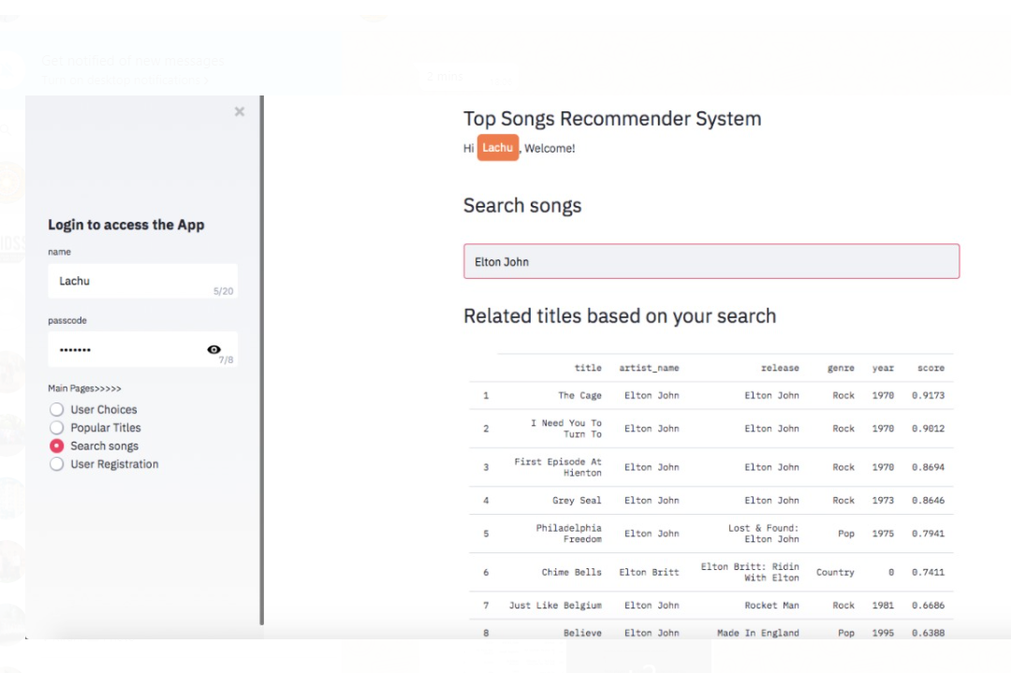
Loading the data in Google colab
EDA
Popularity based filtering
Content based filtering
Collaborative filtering
Understanding the problem and Impact
Project Roadmap
Solution demonstration on UI and effectiveness
Comparative Analysis
One of the snap shots from the UI being created using stream lit
Note : We have covered till Content based Recommendation

Slide 3
Meaningful Insights from the data
- Key Insights from the Internal & external datasets were shared as a part of EDA in Milestone 1
- We are using external data for enrichment which can be used specifically for our content based recognition.
We have used the Genre dataset (Genre, Title, Artist name, Release) which has and further lyrics dataset for enriching data for our content based filtering.
We have cleaned the data by removing duplicates as per song IDs wherever possible
REFINED INSIGHTS
Using Modeling Techniques based on Insights
We could implement popularity-based recommendation system very quickly with existing features provided.
We faced challenges while processing large data set using NLTK, we have successfully managed that issue by using another library – Gensim for content based recommendations.
We are also checking the sentiments analysis, using a small dataset using “ nltk.sentiment.sentiment_analyzer”.
Finally we are going to use Collaborative filtering as well.

Slide 4
DATA PROCESSING PIPELINE
Redefining insights using 5-Steps of Feature Engineering for Music Recommendation Engine
1
2
3
4
5
Artist + Track Data
Process Song DB
Songs Data
Genre Data
Lyrics BoW
Original data set provided by GreatLearning Team as input
Add Track ID and Artist data from SQLite track_metadata.db
Add genre data to songs provided by TU Wien Informatics
MusicXMatch dataset containing a list of the 5000 words the most used in the songs in Bag of Word format
Handle missing values
Handle null
Handle duplicates
Drop unimportant features

Slide 5
Comparison & basic
techniques used while designing
We are using Gensim for content based recommendation as its design to handle large text collections and does not need to have everything in memory at once.
Based on few dataset we are also trying to do sentiment analysis.
Different approaches used in Content based
Recommendation
Different approaches used in Popularity based recommendation
Based on play count (i.e. number of times a song is played) (From Original dataset)
Based on ratings and Num of Votes (New dataset)
A. New dataset gives us an extra dimension towards popularity.
Popularity based helps us with cold start problem. The same we have used in streamlit application to give the user/customer flawless experience.
Content based will help user in searching as well as would be able to give recommendation on relative content. On top of it will also help in recommending based on sentiments
Collaborative filtering will recommend based on latent features. We are yet to start this
Comparison of Popularity based, content based and collaborative based recommendation

